Slide 1
T40
Solar Power Generation
Course project
Intermediate presentation
Gustav Nikopensius
Lauri Lopp
Martin Leissoo
Notes:
We ARE GML, and we chose the kaggle “competition solar power generation data” as our course project

Slide 2
The Team
Lauri Lopp - Clustering
Martin Leissoo - Clustering
Gustav Nikopensius - Predictions

Slide 3
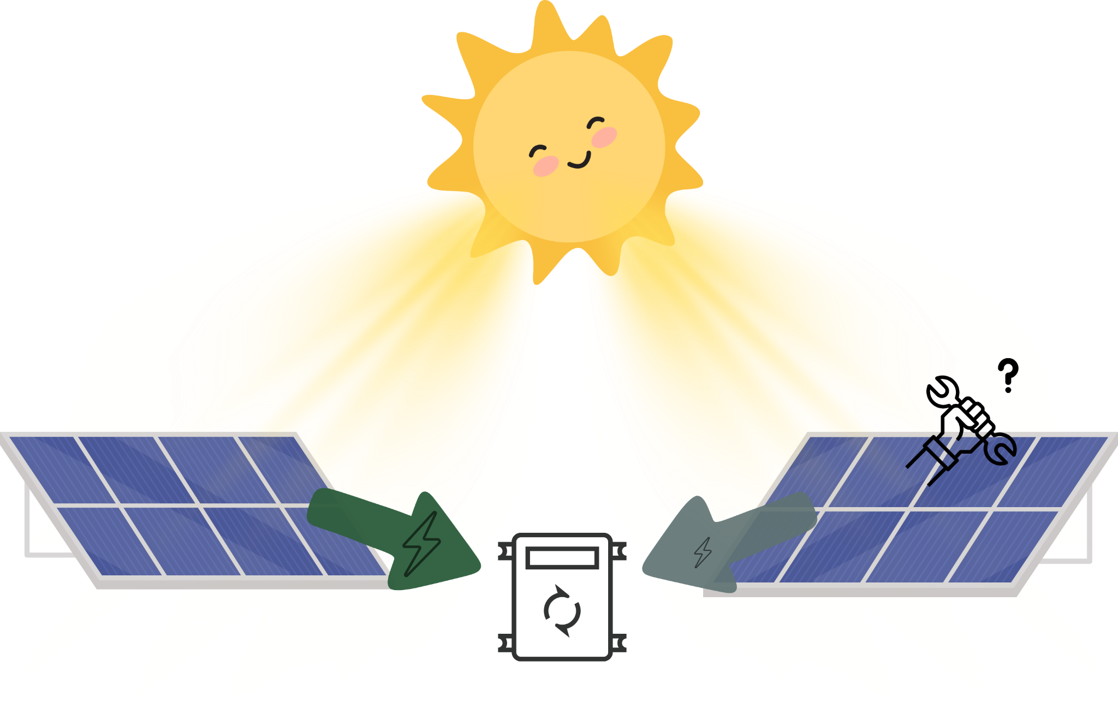
Three tasks
Understand and process data
Classify faulty equipment
Predict power output
Notes:
Basically we have two solar plants in india, consisting of many solar panels, which get hit by photons from the sun (IRRADIATION) and convert that energy to electricity, or DC current. Our challenge is to understand the data from these two plants and see if we can identify faulty suboptimal equipment

Slide 4
Predicting power output
Use predictive machine learning models
Baseline model
Linear Regression
Radiation –predict→ Power
More sophisticated models
LSTM
XGBoost
All available weather and equipment information

Slide 5
Why predict power output?
Optimize plant operations
Plan and schedule maintenance
Cleaning solar panels
Economic optimization
Meet energy commitments
Avoid penalties
Environmental benefits
Reduce carbon footprint
Reduce dependency on backup fossil fuel generators

Slide 6
LSTM
Hyperparameters
Dropout
L2 regularization
MAE = 90(kW)
E(y) = ~280(kW)
Linear Regression baseline MAE = 80(kw)
Failed expectations

Slide 7
XGBoost
R-squared = 0.86
MAE = 50(kW)
Surpasses baseline model
And our expectations
Hyperparameter tuning with Cross-validation
Number of estimators
Learning rate
Max depth
Min child weight
Gamma
Regularization alpha
Regularization lambda

Slide 8
Training data
Weather data
Ambient air temperature
Module surface temperature
Irradiation
Plant and equipment data
Inverter ID
Plant ID
Weather sensor ID

Slide 9
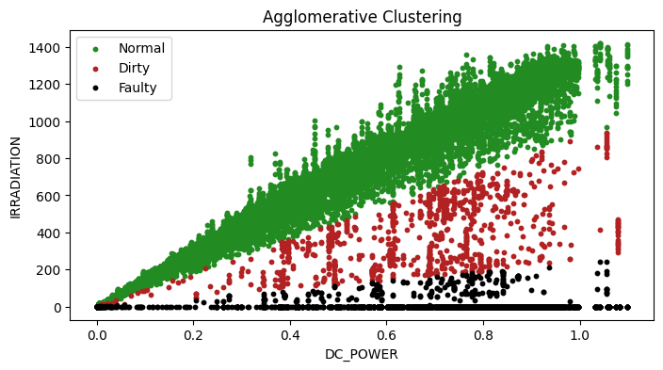
Finding underperformers
Notes:
Visualization
Understading
Clustering based on new Feature - DC/IRR
Clustering with different algorithms

Slide 10
Results
Plant 1
Fitting data:
Silhouette Score = 0.881
“Future” data:
Silhouette Score = 0.904
Plant 2
Fitting data:
Silhouette Score = 0.876
“Future” data:
Silhouette Score = 0.877
Some visualizations as well
(how on fitting and how on future)
Notes:
Future usage - e.g. if ~10% of the poits are clustered “Faulty” in one day, the alarm is raised

Slide 11
What we learned
Understanding the data is difficult
Used LSTM for the first time
Next time, for predictions, would remove night time data where production is 0 anyway

Slide 12
Thank you
for your
attention!

Slide 13
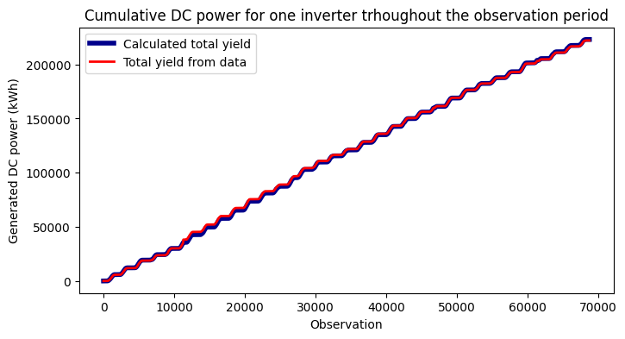
Understanding the data

Slide 14
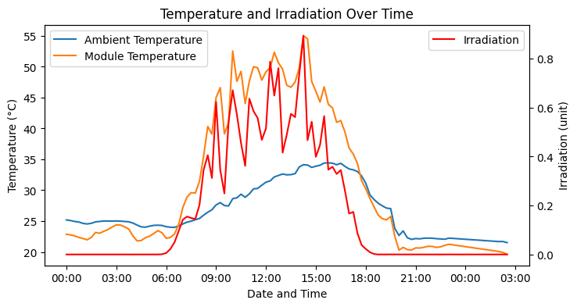
Understanding the data

Slide 15
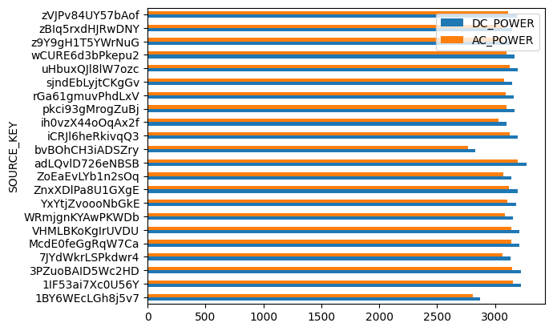
Understanding the data

Slide 16
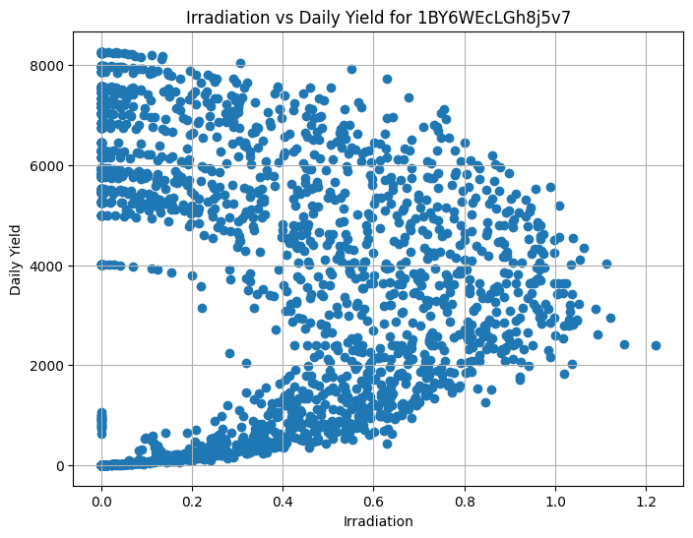
Understanding the data

Slide 17
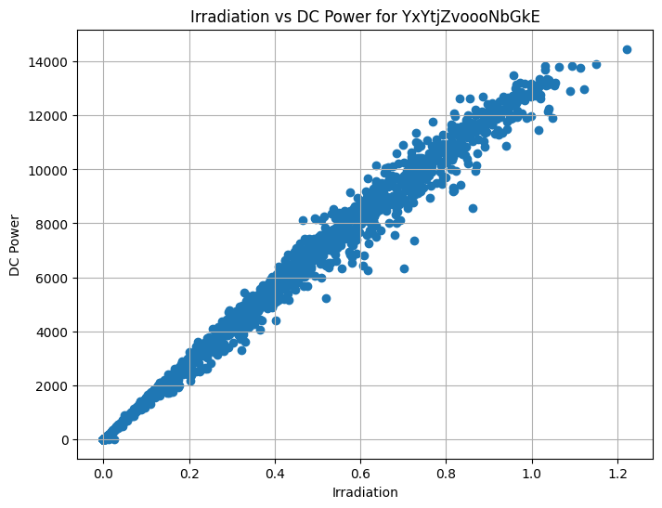
Power and Radiation

Slide 18
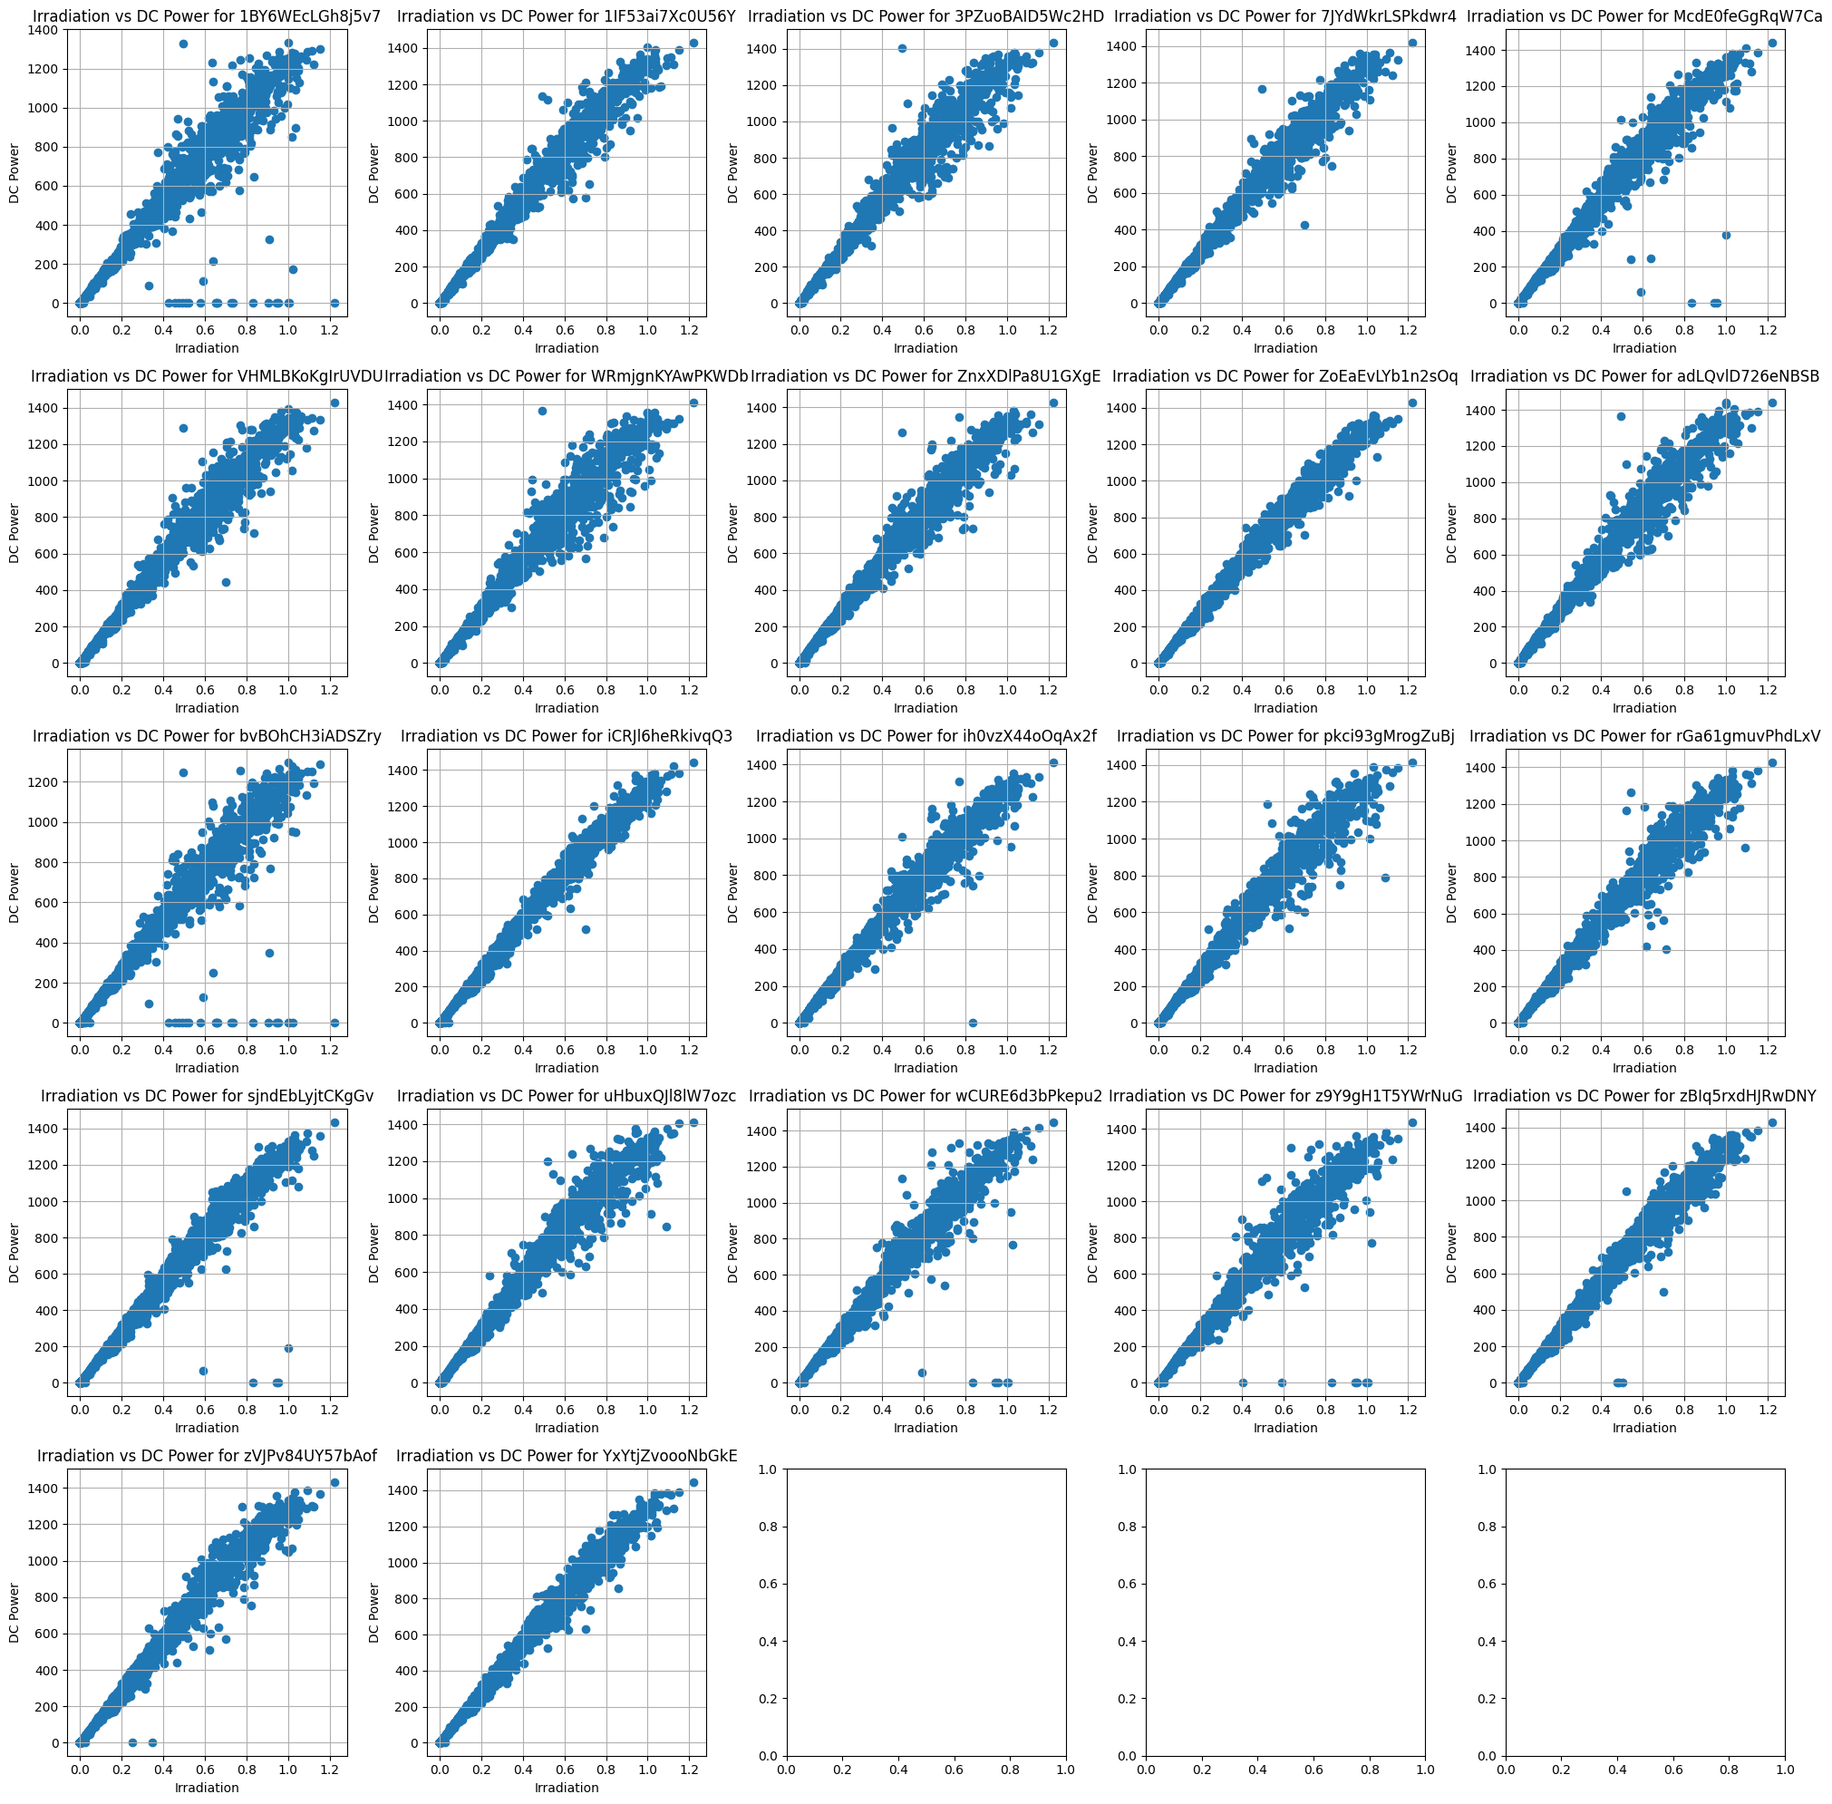
Plant 1

Slide 19
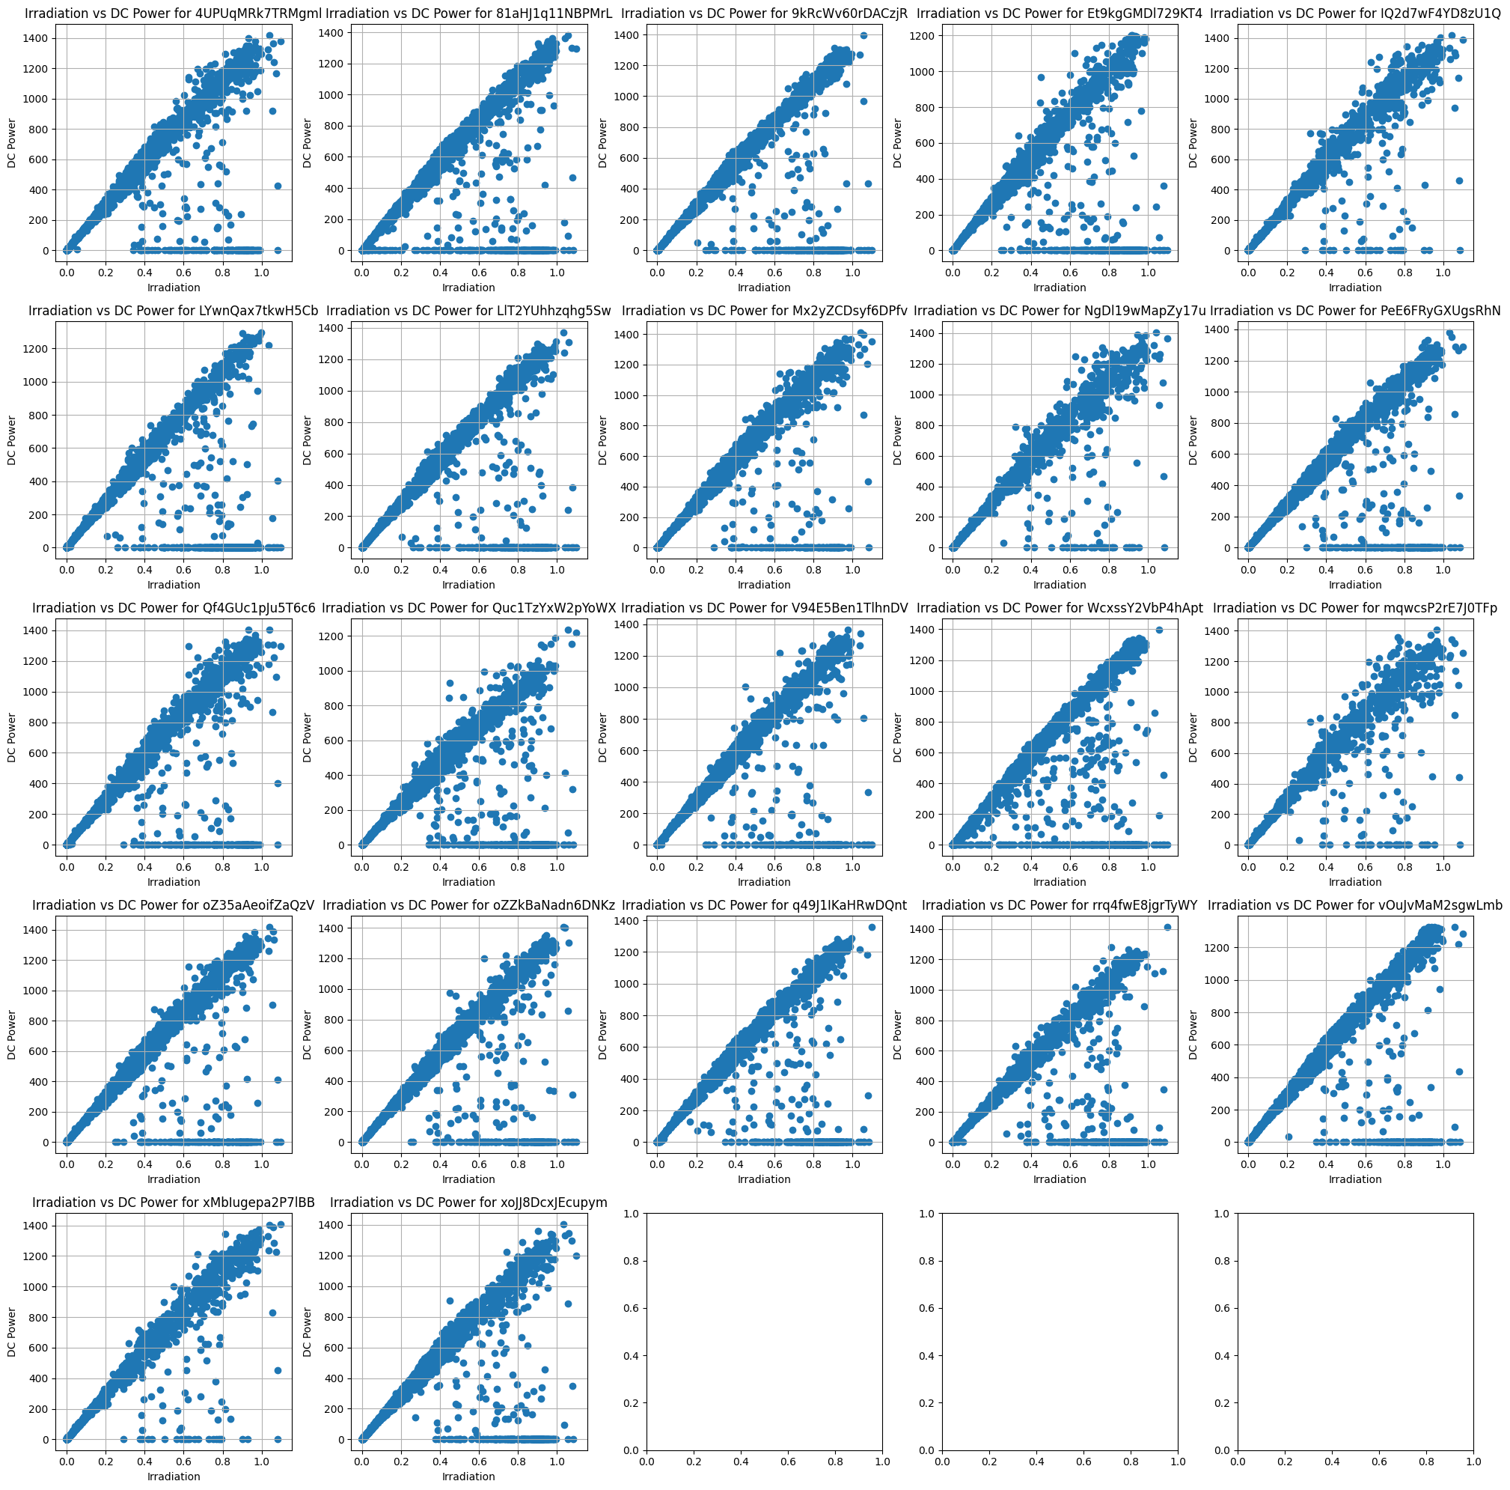
Plant 2

Slide 20
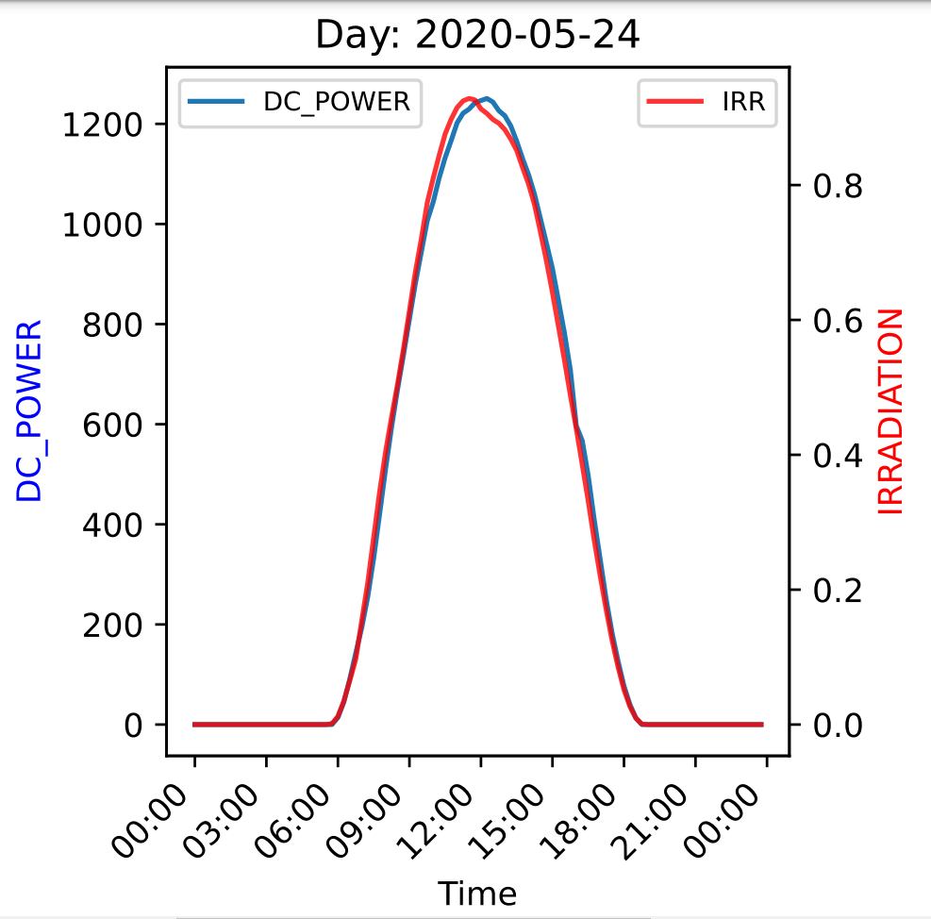
Power and Radiation on a timeline
Single inverter production in one day

Slide 21
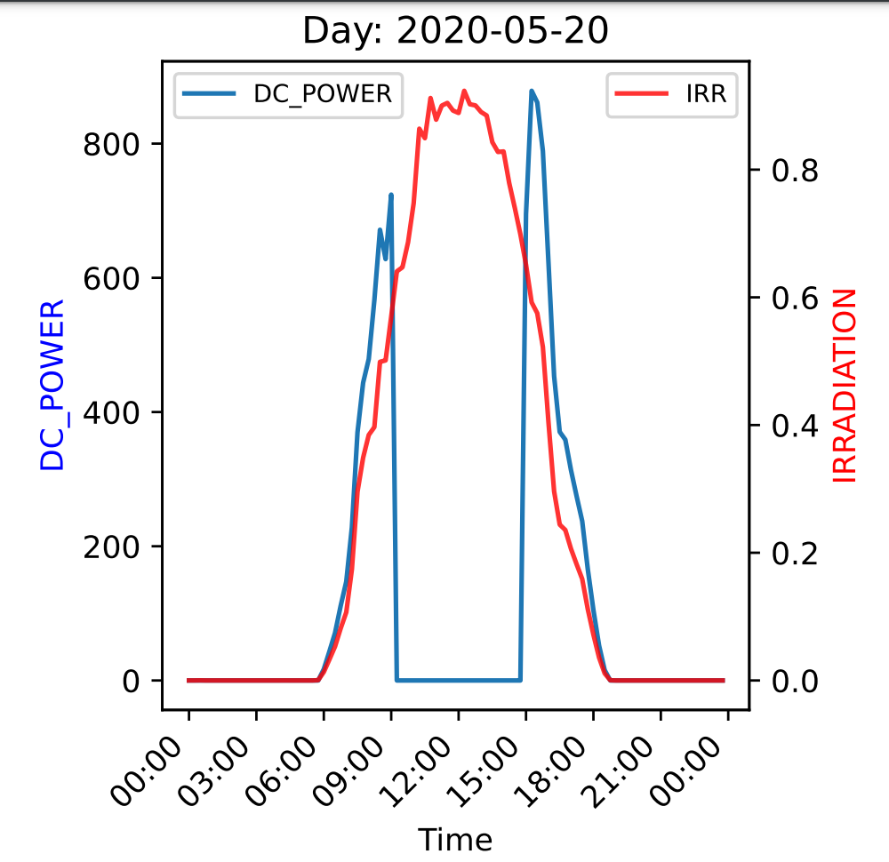
Classifying faulty equipment
Challenge:
No labels for equipment health
Normal
Faulty

Slide 22
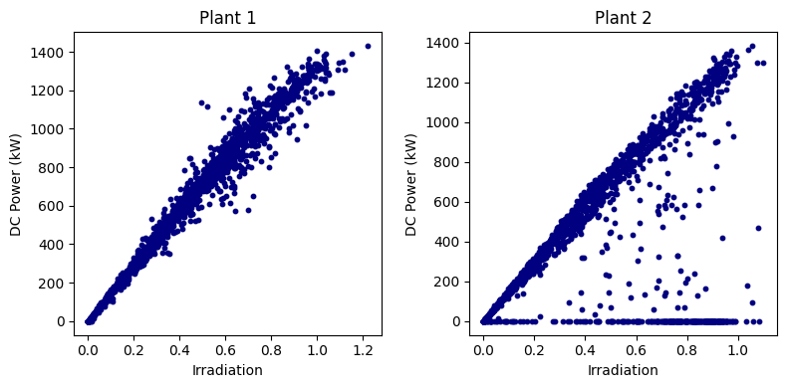
Visualizing the problem
?

Slide 23
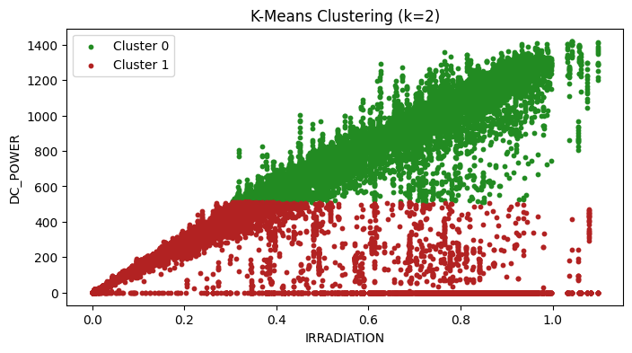
Unsupervised learning
Notes:
K-means (k=2) and the DC power and Irradiation is used to cluster. The clustering has not been succsessful

Slide 24
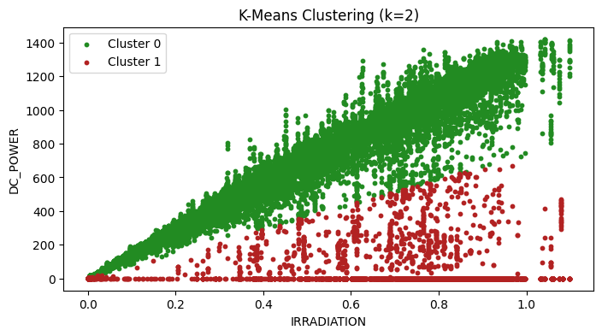

Unsupervised learning
Notes:
Here, instead of features separately, the ratio DC/IRR is used for clustering and here we can see that

Slide 25

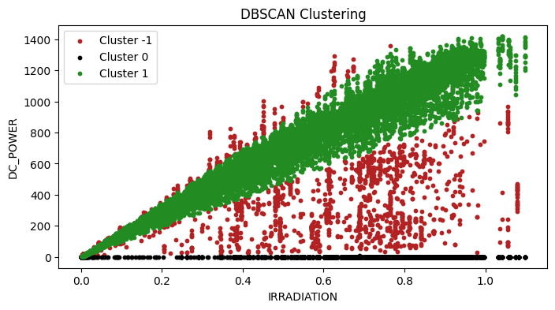
Unsupervised learning
Notes:
K-means is replaced with dbscan and the parameters are adjusted so that we can get three classes.
Cluster -1 : noise
Cluster 0 : normally working inverters
Cluster 1 : faulty inverter

Slide 26
Predicting power output
Gustav
Challenge:
Dataset contains data from faulty equipment
Solution:
Exclude faulty equipment data
Train a more sophisticated model

Slide 27
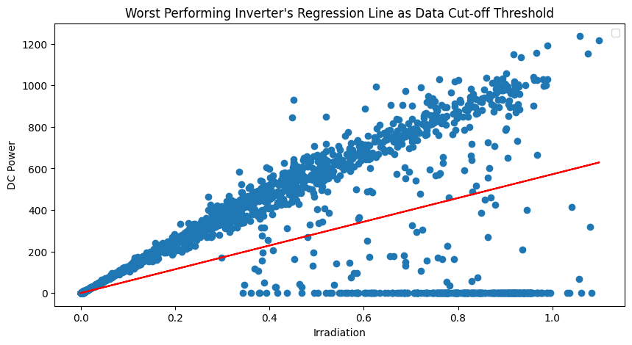
Exclusive approach

Slide 28
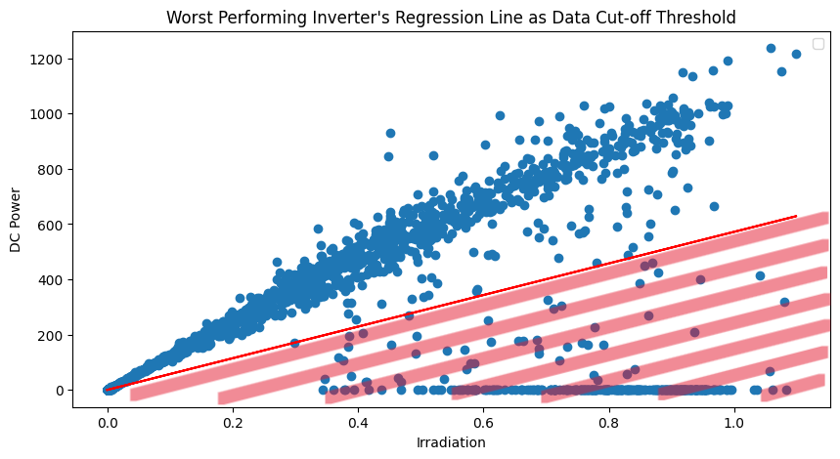
Exclusive approach

Slide 29
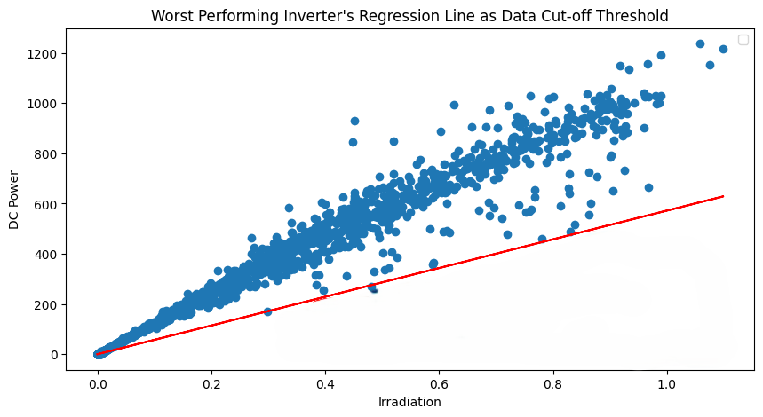
Exclusive approach

Slide 30
Exclusive approach

Slide 31
Inclusive approach
Equipment health labels from classification task
LSTM
Temporal dimension

Slide 32
Inclusive approach
Sunny day

Slide 33
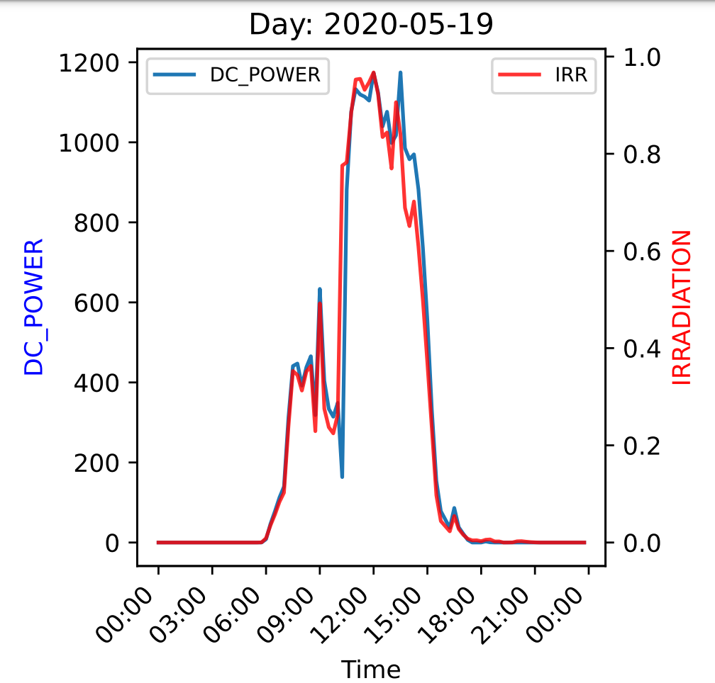
Inclusive approach
Cloudy day

Slide 34
Inclusive approach
Faulty equipment

Slide 35
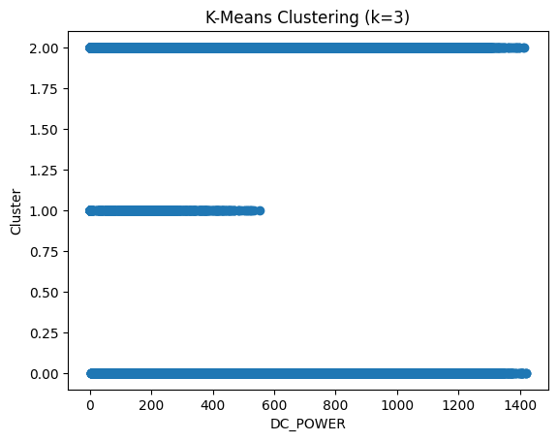
Unsupervised learning

